Slide 1

Netflix Movie Genre Analysis
Exploring distribution, popularity, and trends in film data.

Slide 2

Key Findings Overview
Genre Frequency
Highest Popularity
Drama is the most frequent genre in the dataset.
Drama also holds the highest popularity among fans.
Peak Production Year
The year 2020 recorded the highest filming rate.

Slide 3





Genre Distribution: The Dominance of Drama
Most Frequent Genre
Drama is the most frequent genre, appearing more often than 19 other genres in the dataset.
Popularity Leader
Drama again receives the highest popularity among fans, securing over 18.5% of movie popularities.

Slide 4



Fan Engagement: Popular Vote
A significant portion of our dataset reflects high fan engagement, with 25.5% of movies having a popular vote (6,520 rows).
25.5%
Dataset with Popular Vote
Indicates high fan engagement and voting activity.
18.5%
Drama's Popularity Share
The genre with the largest share of popular votes.

Slide 5

Highest Popularity: Spider-Man: No Way Home
Spider-Man: No Way Home
This film achieved the highest popularity rate recorded in our dataset.
Action
Adventure
Science Fiction

Slide 6



Lowest Popularity: The United States and Thread
Lowest Popularity Rate
The movie "The united states and thread" registered the lowest popularity rate in our dataset.
Diverse Genres
Its genres include Music, Drama, War, Sci-Fi, and History.

Slide 7

Peak Filming Year: 2020
The year 2020 stands out as having the highest filming rate in our dataset, indicating a significant period of production activity.
2020
Highest Filming Rate
Year with the most movies filmed in the dataset.

Slide 8
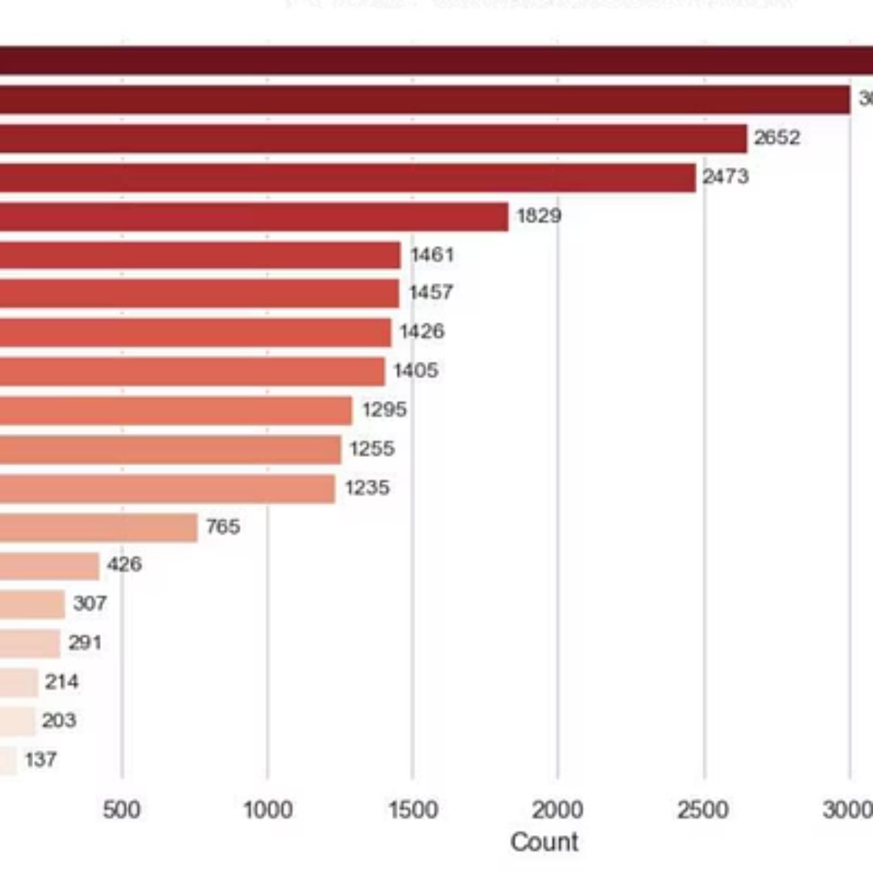
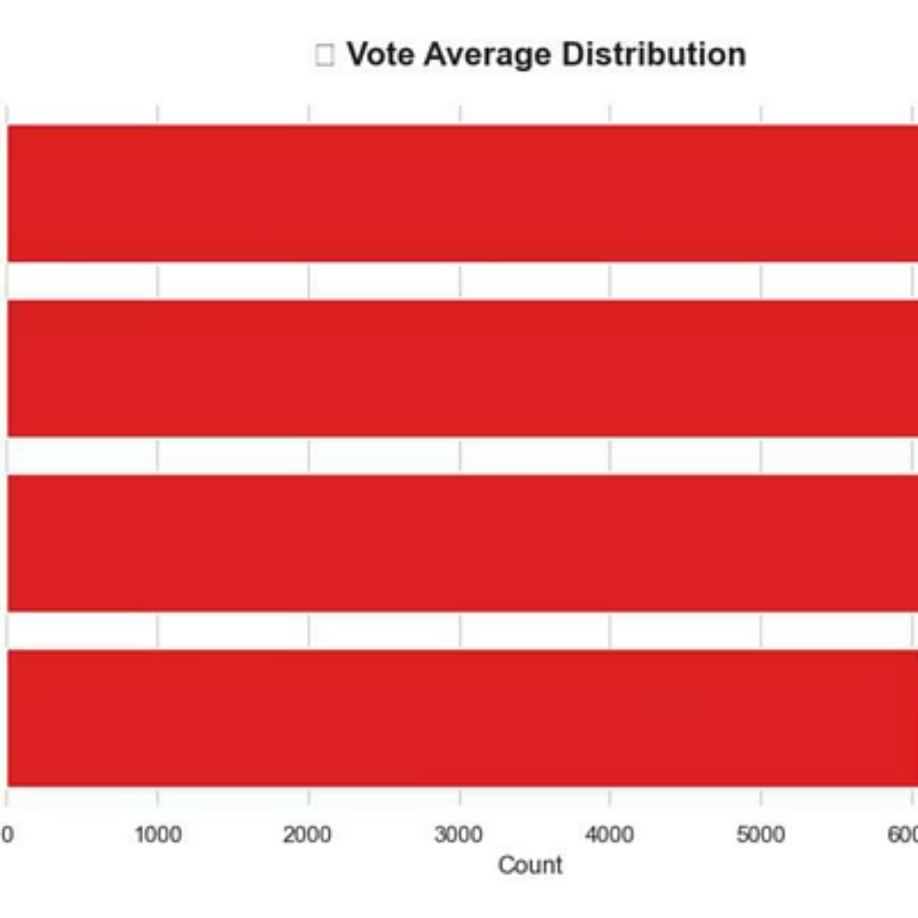
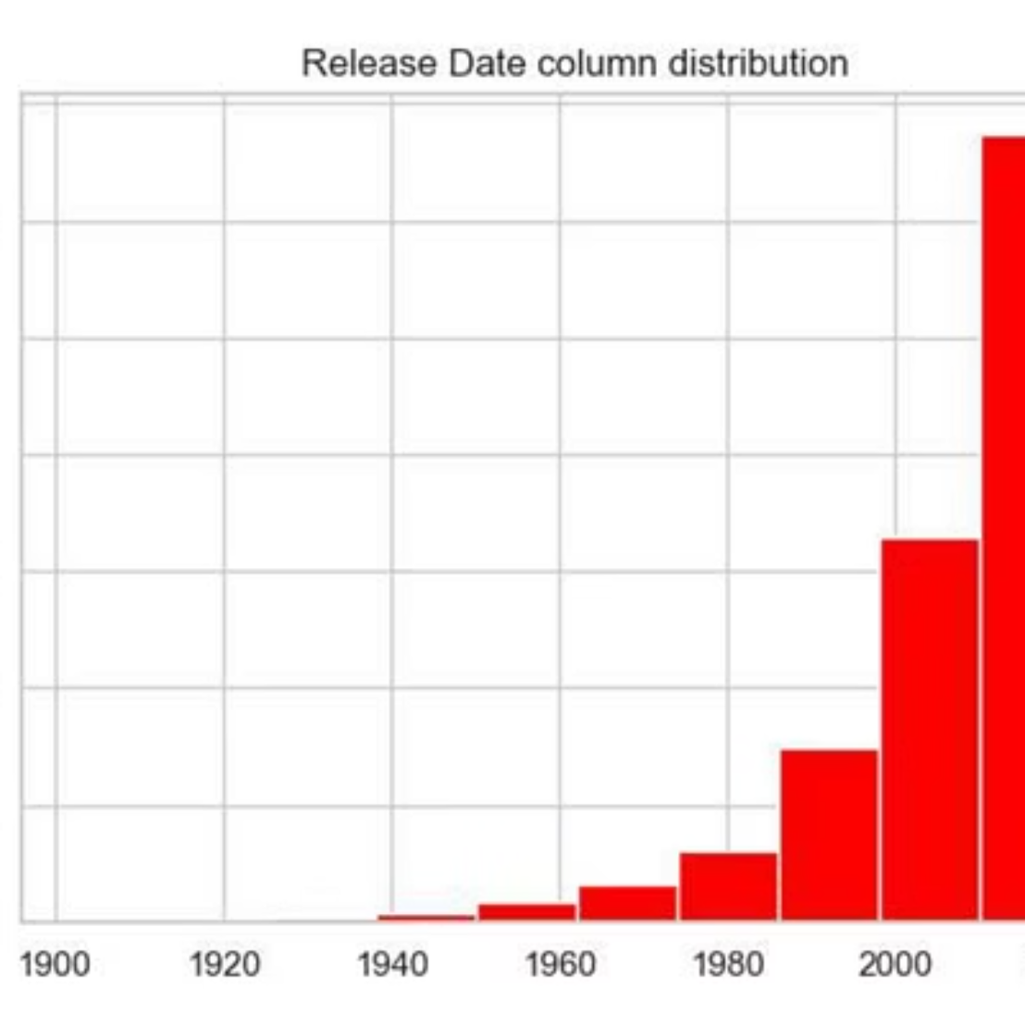
Visualizing Genre Trends
The following charts illustrate the distribution and popularity of genres, highlighting the dominance of Drama.

Slide 9





Production Activity Timeline
2018
2020
Steady growth in film output
Clear peak in production volume
2019
2021
Increased production momentum
Post-peak normalization begins
Understanding the peak in 2020 helps us analyze market shifts and production capacity during that period.

Slide 10



Summary and Next Steps
Confirm Drama's Influence
Analyze Popularity Drivers
Examine 2020 Peak
Drama is both the most common and most popular genre, suggesting a strong market for character-driven narratives.
Investigate factors contributing to the extreme popularity of outliers like "Spider-Man: No Way Home."
Further research is needed to understand the specific dynamics that led to the highest filming rate in 2020.

